Slide 1
PROJECT –1
Title: AWS Architecture for Highly Available and Scalable Web Application.
Subtitle: Leveraging EC2, RDS, and Load Balancing for Optimal Performance.
PRESENTED BY -
VISHNU VARDHAN

Slide 2
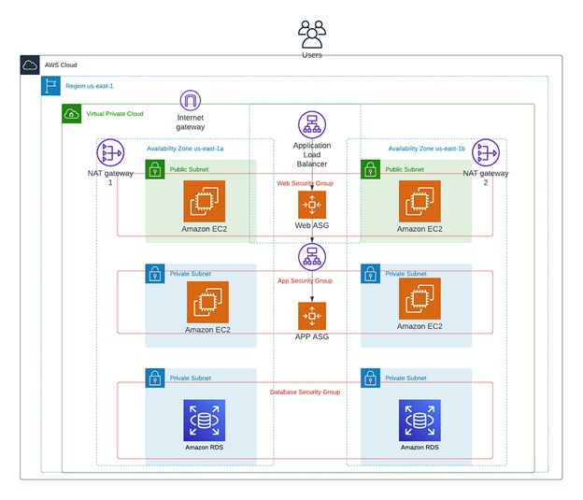
AWS ARCHITECTURE

Slide 3
ARCHITECTURE OVERVIEW
Above diagram represents a multi-tier, highly available AWS architecture, designed to run a scalable web application.
Key Components:
Amazon EC2 Instances: For running web and app servers.
Amazon RDS: Managed relational database service.
NAT Gateway: For outbound internet access from private subnets.
Application Load Balancer (ALB): For distributing incoming traffic across EC2 instances.

Slide 4
VPC Configuration
Virtual Private Cloud (VPC):
Ensures network isolation.
Divided into multiple subnets, both public and private, across different Availability Zones.
Contains an Internet Gateway for public internet access and NAT Gateways for internet access from private instances.

Slide 5
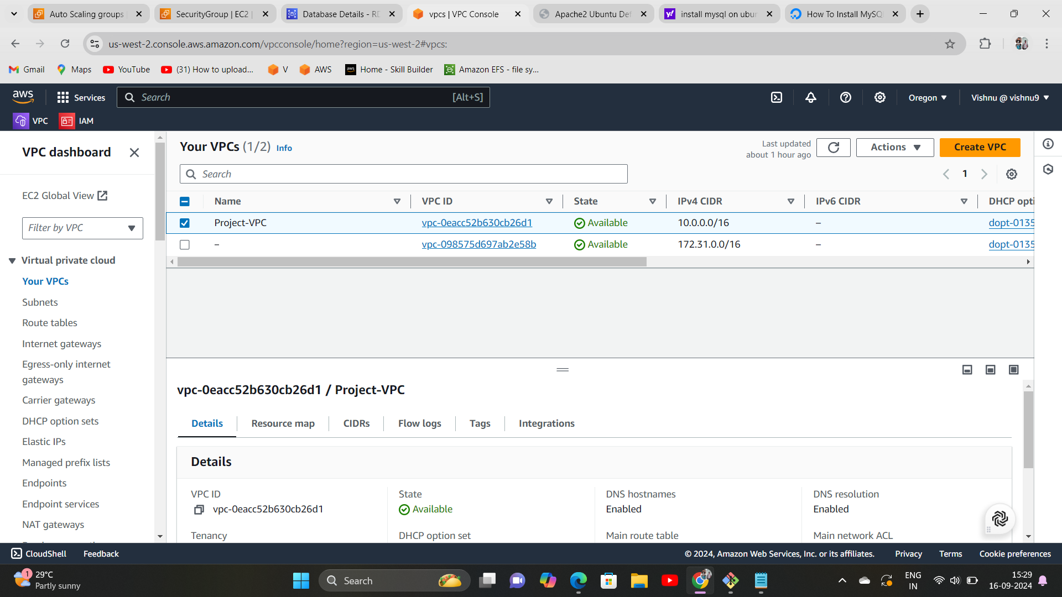

Slide 6
Public and Private Subnets
Public Subnets:
Host the EC2 instances that serve web traffic.
Associated with NAT Gateways to enable internet access from private subnets.
Private Subnets:
Secure layer hosting app EC2 instances and the RDS database.
No direct access to the internet for enhanced security.

Slide 7
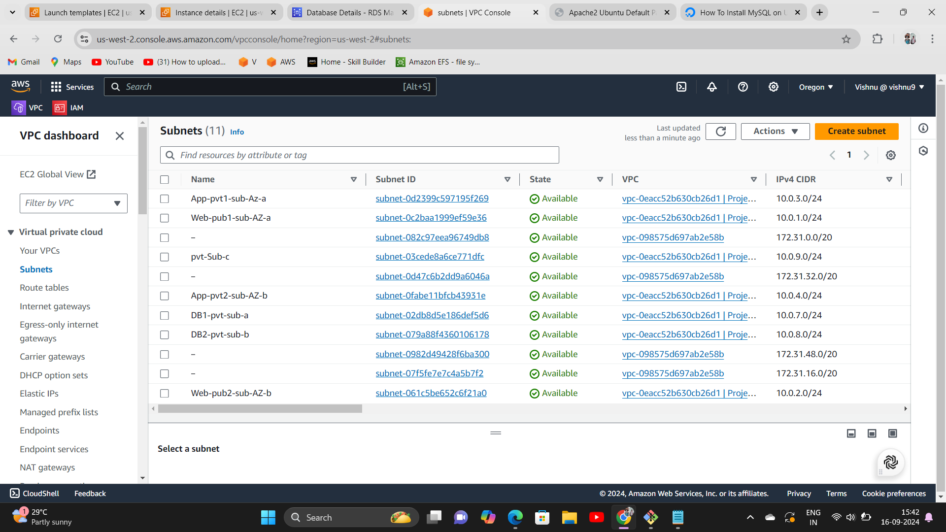

Slide 8
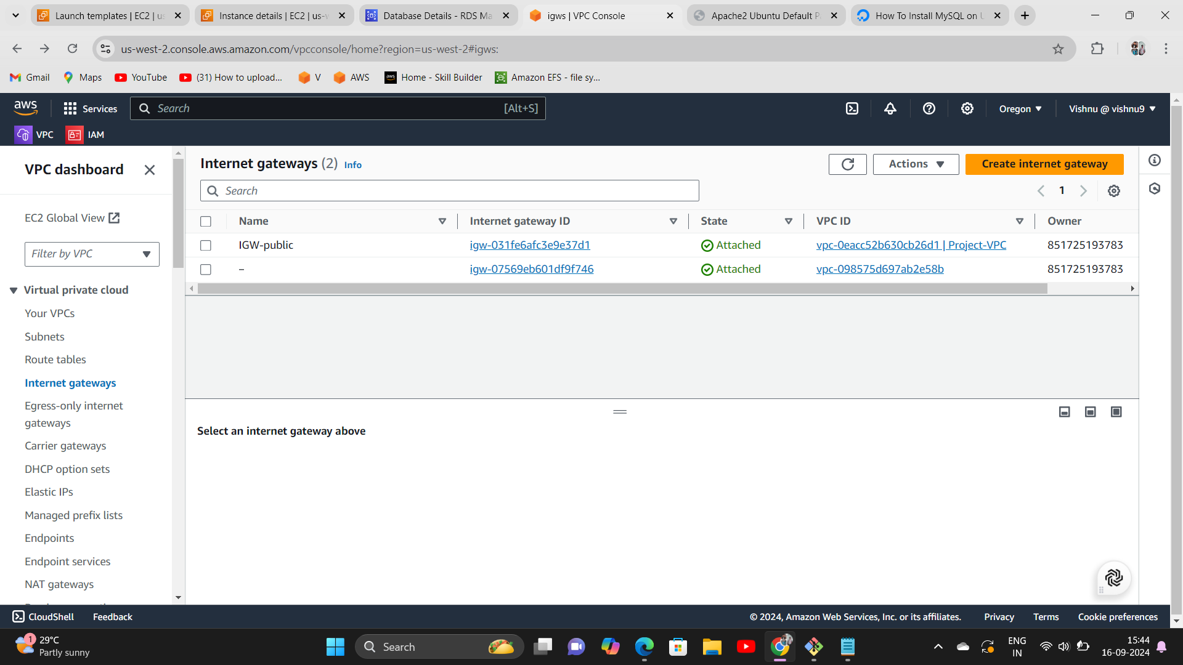
Internet Gateway
The Internet Gateway enables resources in public subnets (like Web EC2 Instances and Load Balancers) to have internet access for:
Receiving traffic from users across the web.
Sending responses back to users.

Slide 9
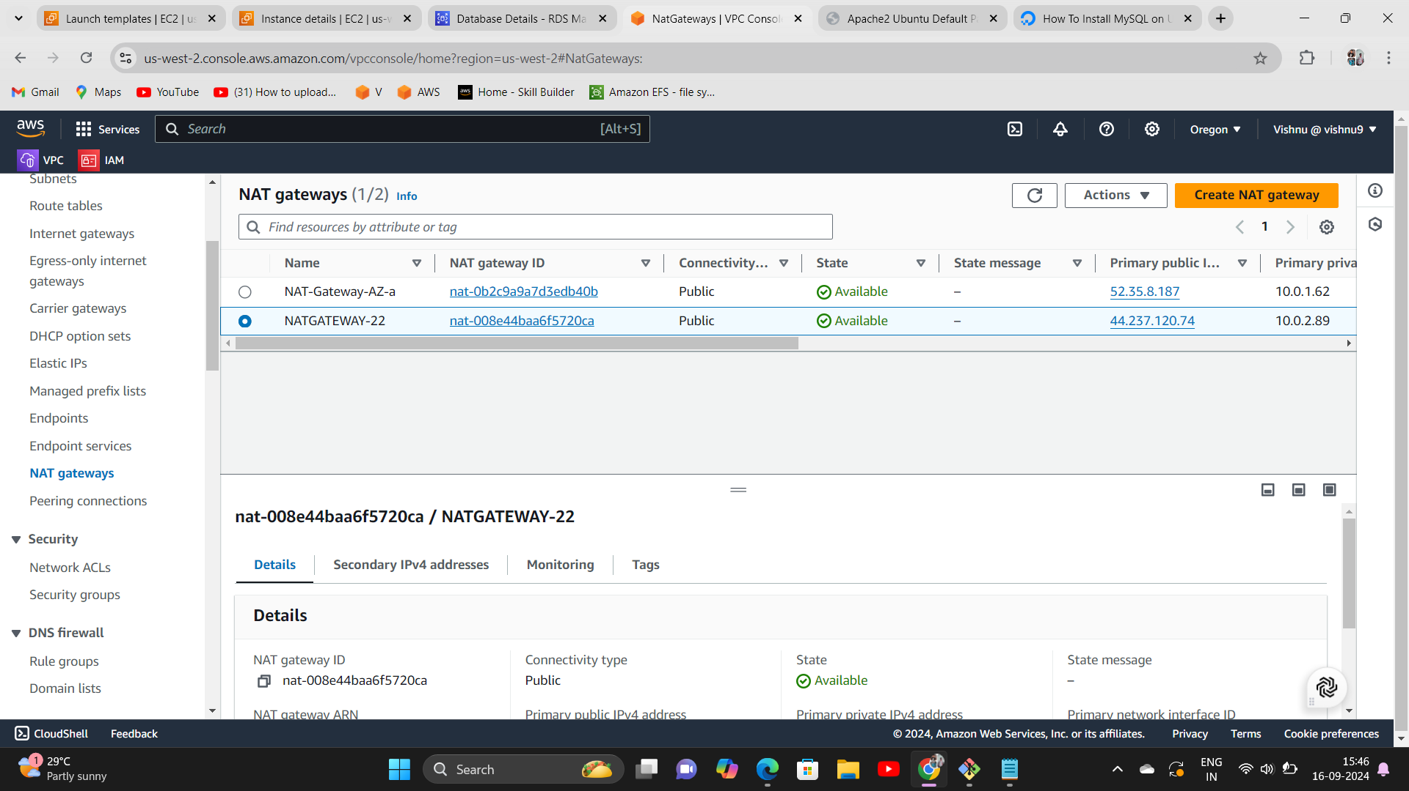
NAT Gateway
NAT Gateway:
Provides internet access to instances in private subnets for software updates or external API calls.
Associated with private EC2 instances to keep them secure while still allowing outbound traffic.

Slide 10
Route Table Configuration
Route Tables manage traffic flow between:
Subnets (public and private).
The Internet Gateway (IGW) for external internet access.
NAT Gateways for private subnet internet access.

Slide 11
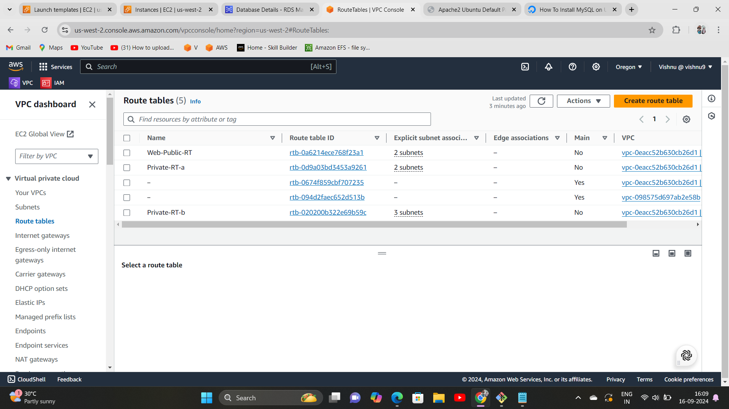

Slide 12
Security Group
Web Security Group:
Controls access to web EC2 instances, allowing only HTTP/HTTPS traffic from the internet.
App Security Group:
Limits access to app servers, allowing only traffic from web servers.
Database Security Group:
Allows access to the RDS instances only from the app layer, securing database traffic.

Slide 13
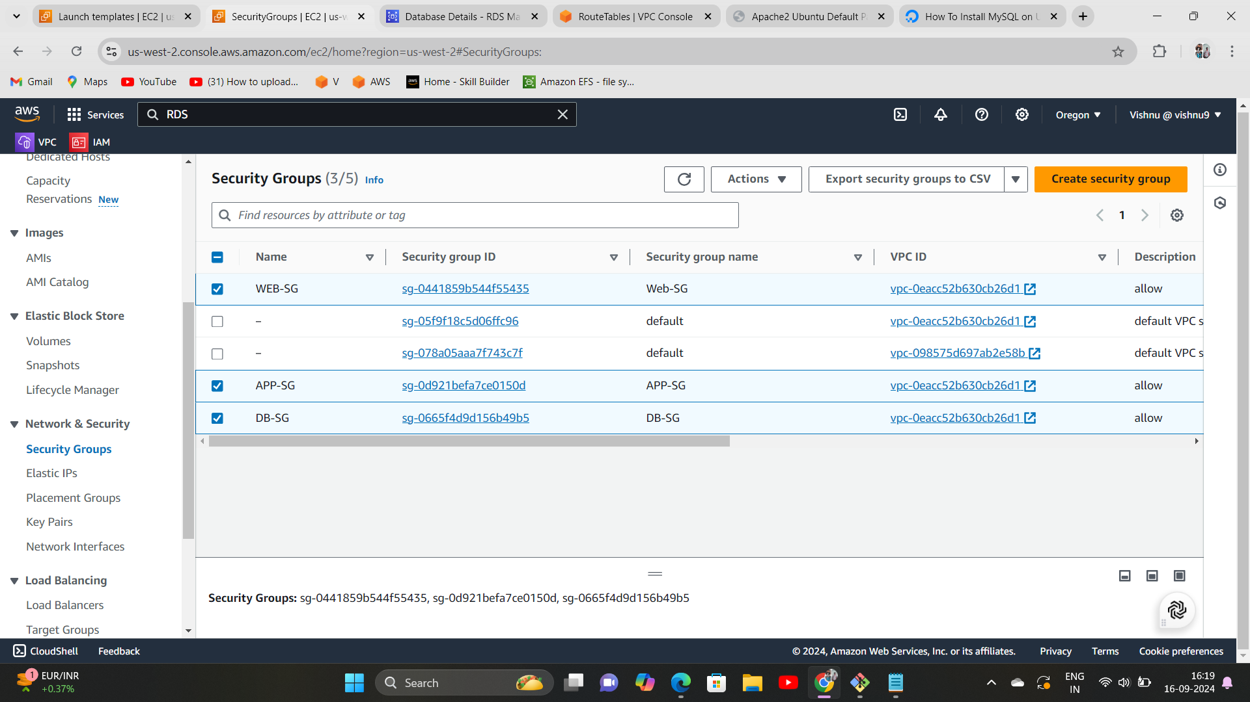

Slide 14
Launch EC2 Instances
EC2 Instances
Amazon EC2 (Elastic Compute Cloud) provides scalable computing capacity.
Used to host both the Web Layer (front-end) and Application Layer (back-end) of our architecture.

Slide 15
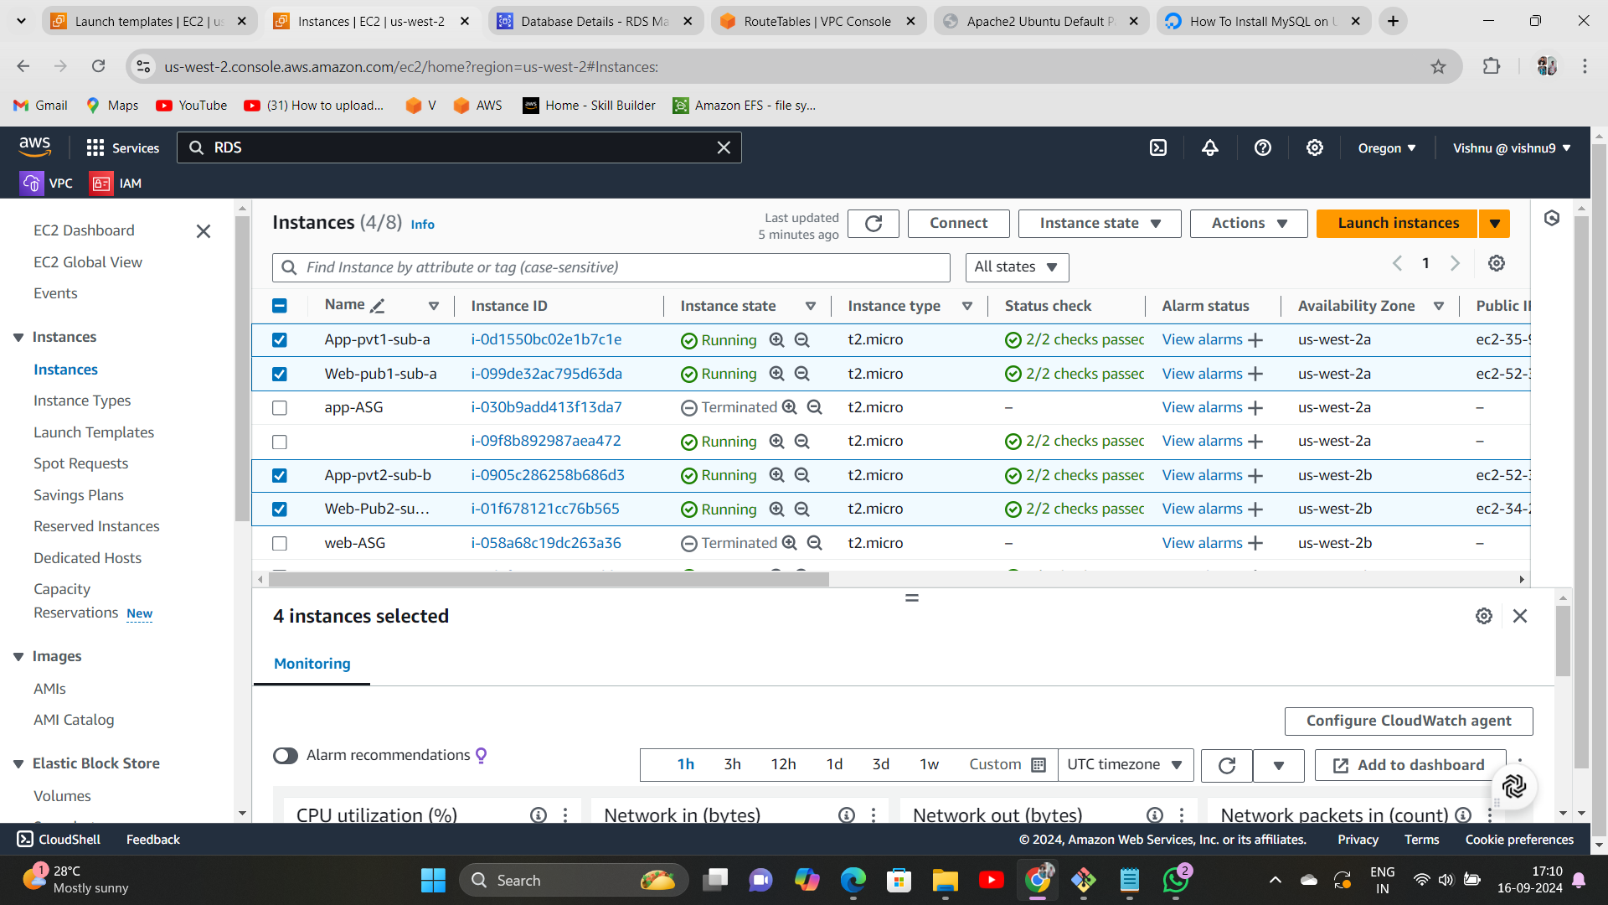

Slide 16
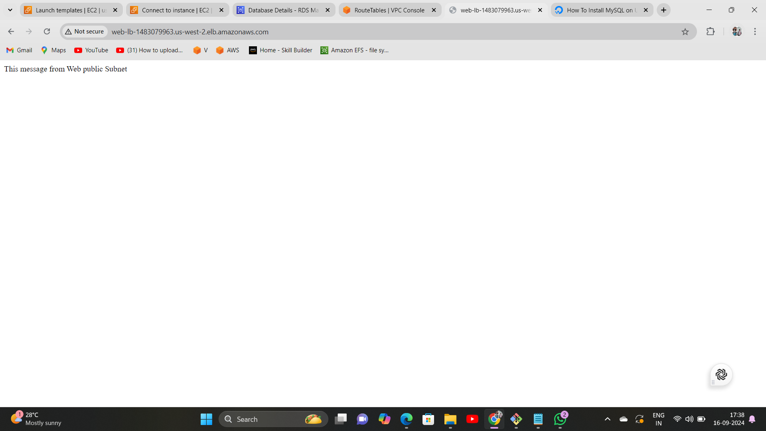
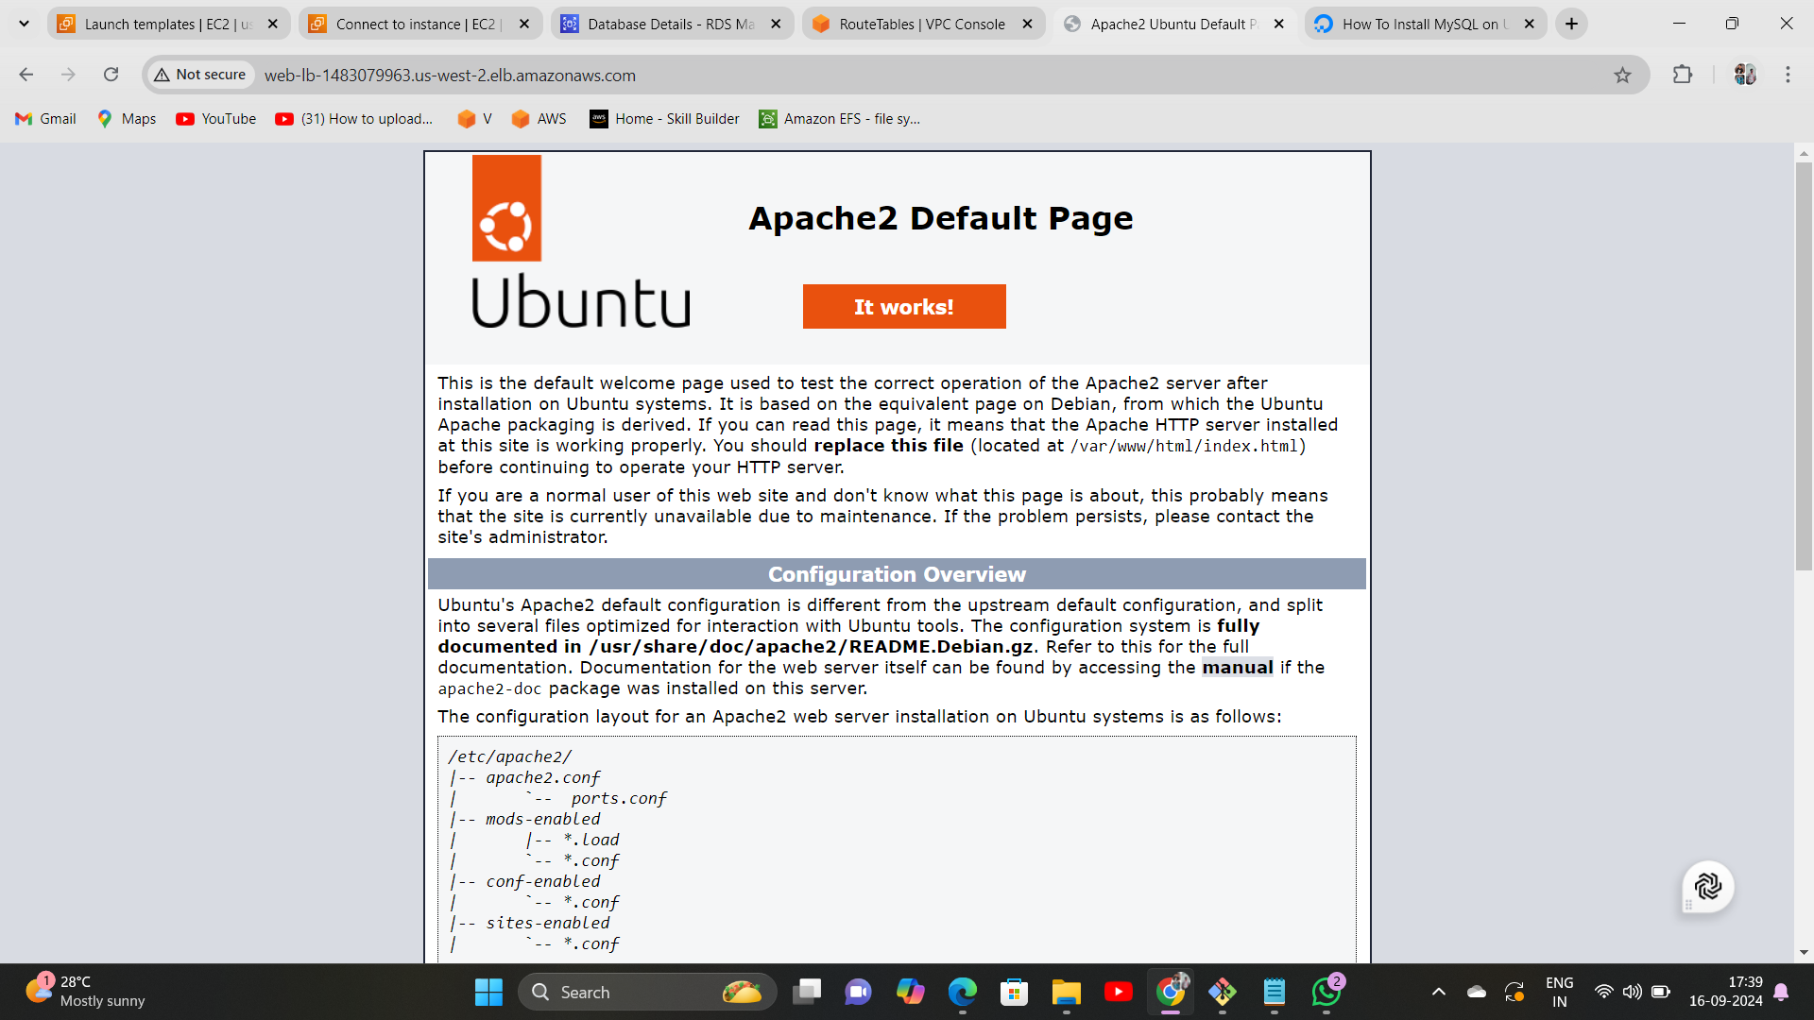

Slide 17
Application Load Balancer
Load Balancer:
Distributes incoming web and app traffic across EC2 instances located in multiple Availability Zones.
Ensures high availability by routing traffic to healthy instances only.

Slide 18
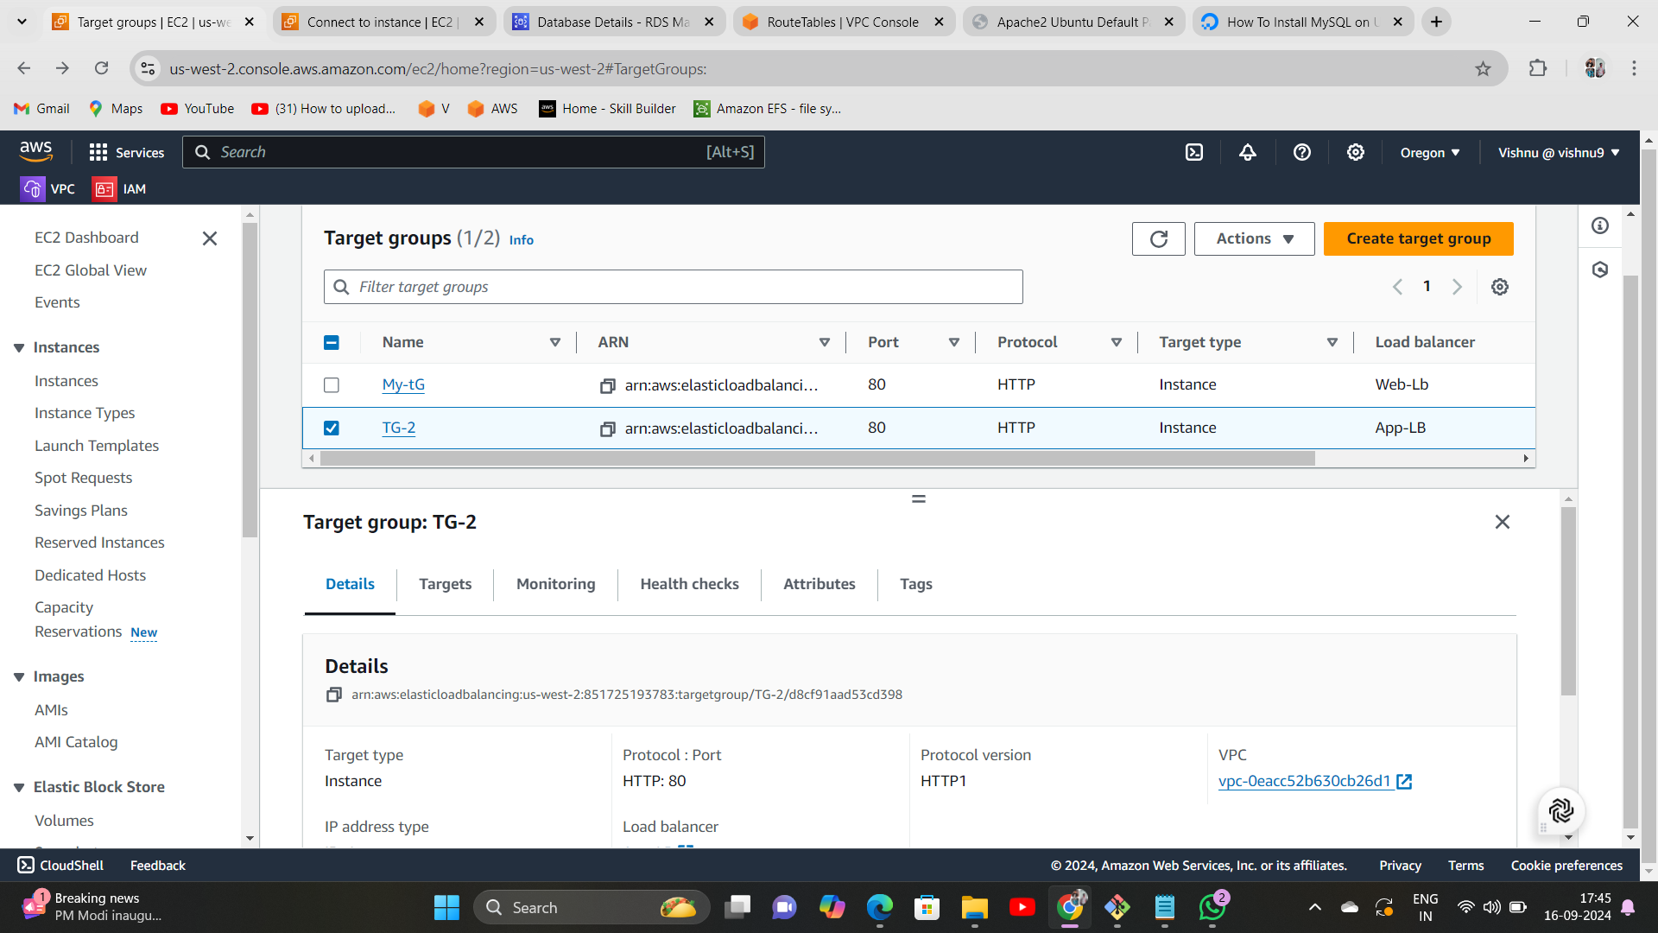
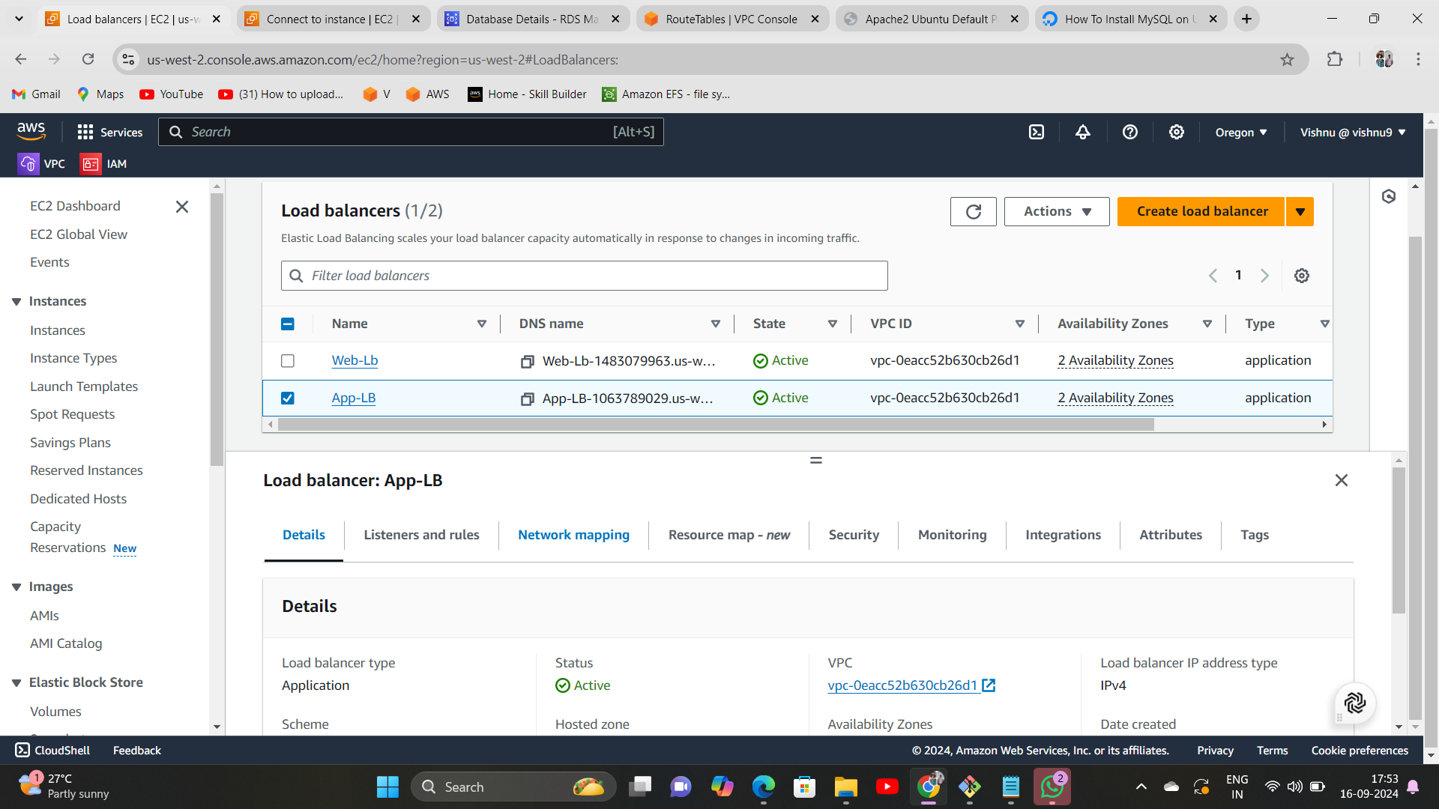

Slide 19
High Availability and Scalability
Auto Scaling Groups (ASG):
Automatically adjusts the number of running EC2 instances based on demand, ensuring both scalability and cost efficiency.
Multi-AZ Architecture:
Each tier (web, app, and database) spans across multiple Availability Zones to ensure high availability and failover.

Slide 20
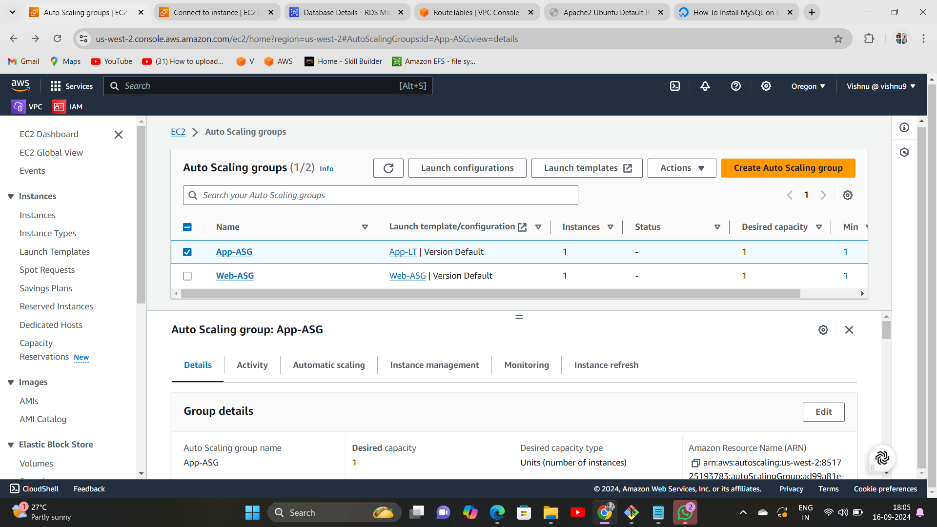
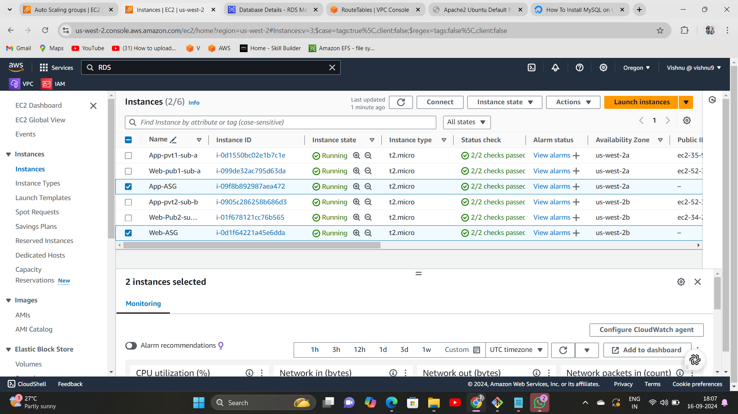

Slide 21
Database Layer(Amazon RDS)
Amazon RDS:
Deployed in private subnets for enhanced security.
Multi-AZ Deployment: Ensures high availability by automatically replicating data to a standby instance in another Availability Zone.

Slide 22
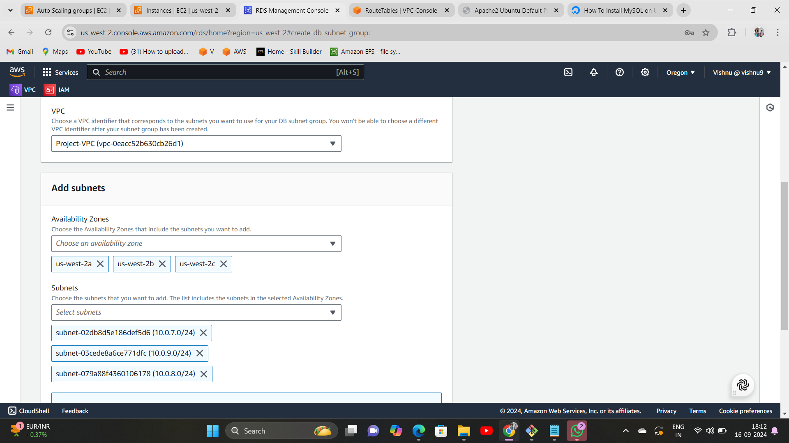
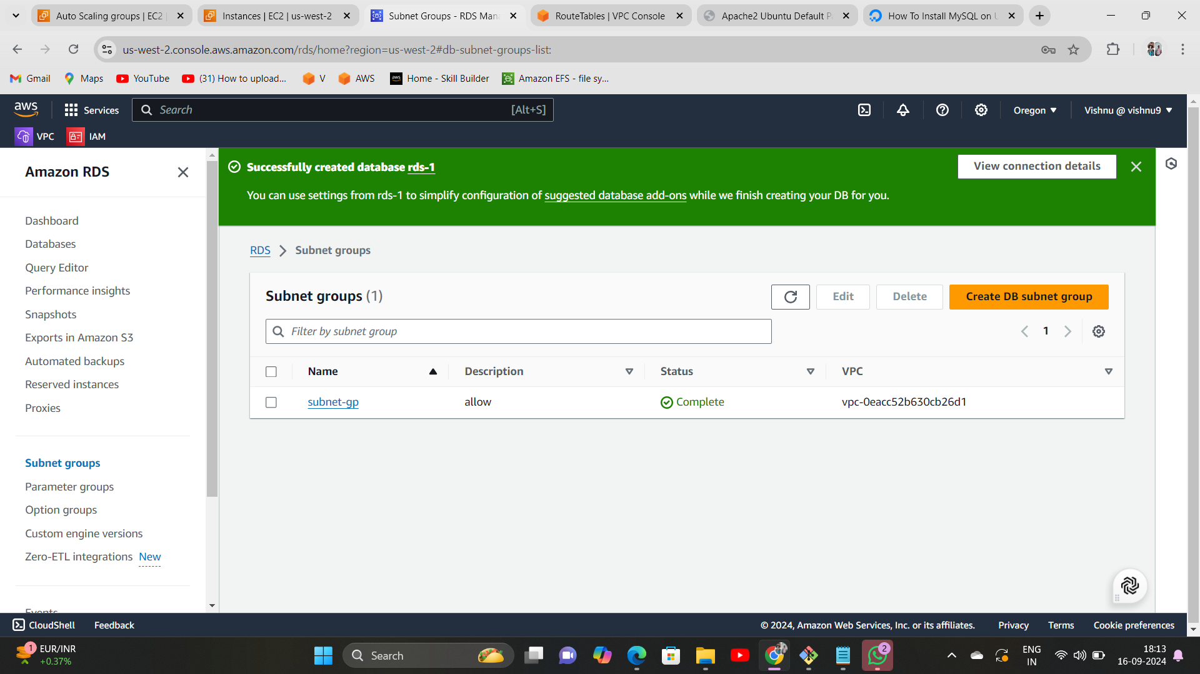
Subnet Group

Slide 23
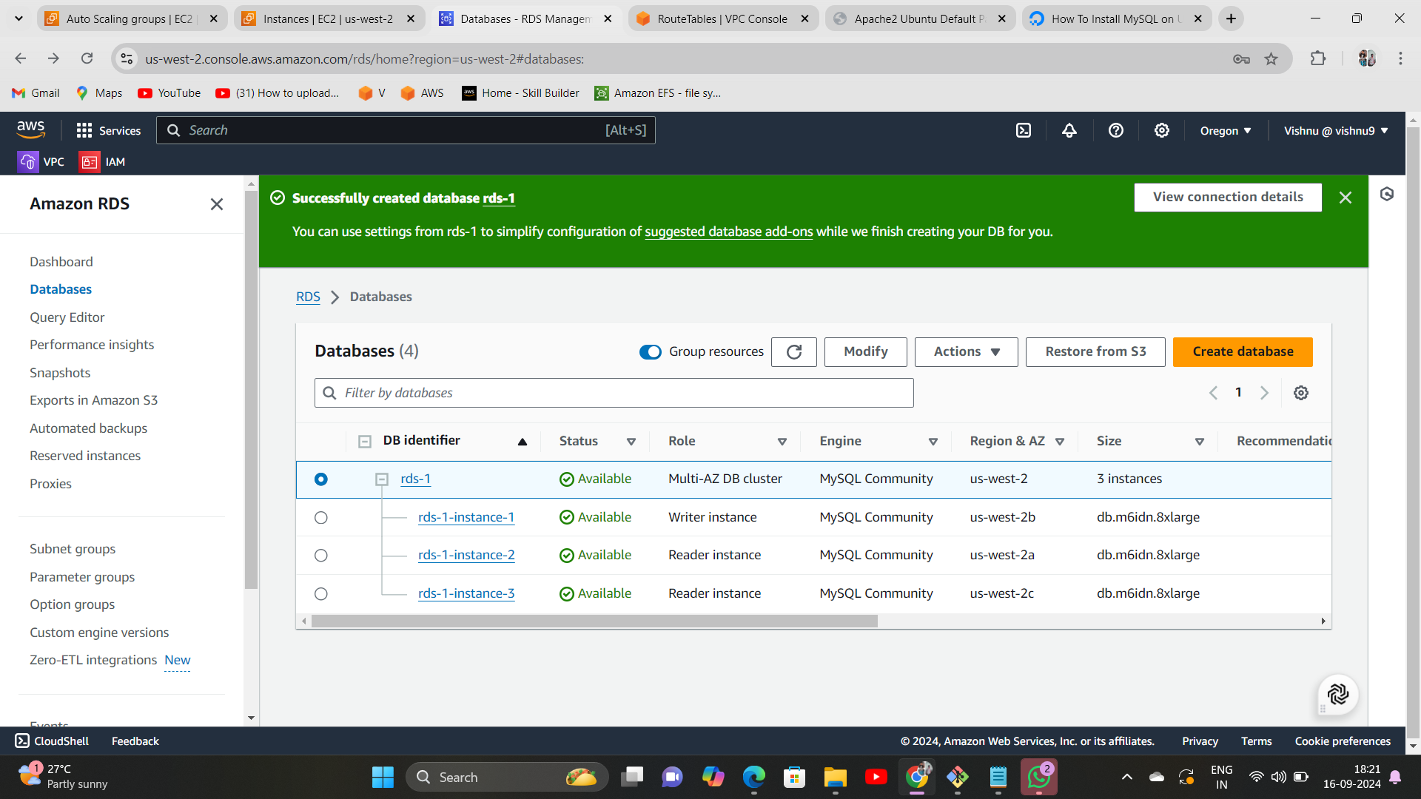

Slide 24
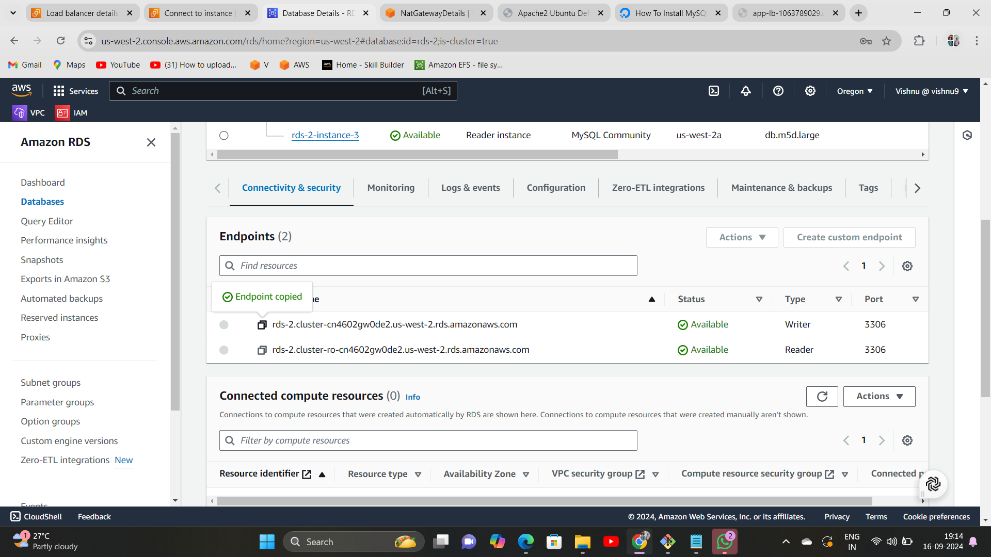
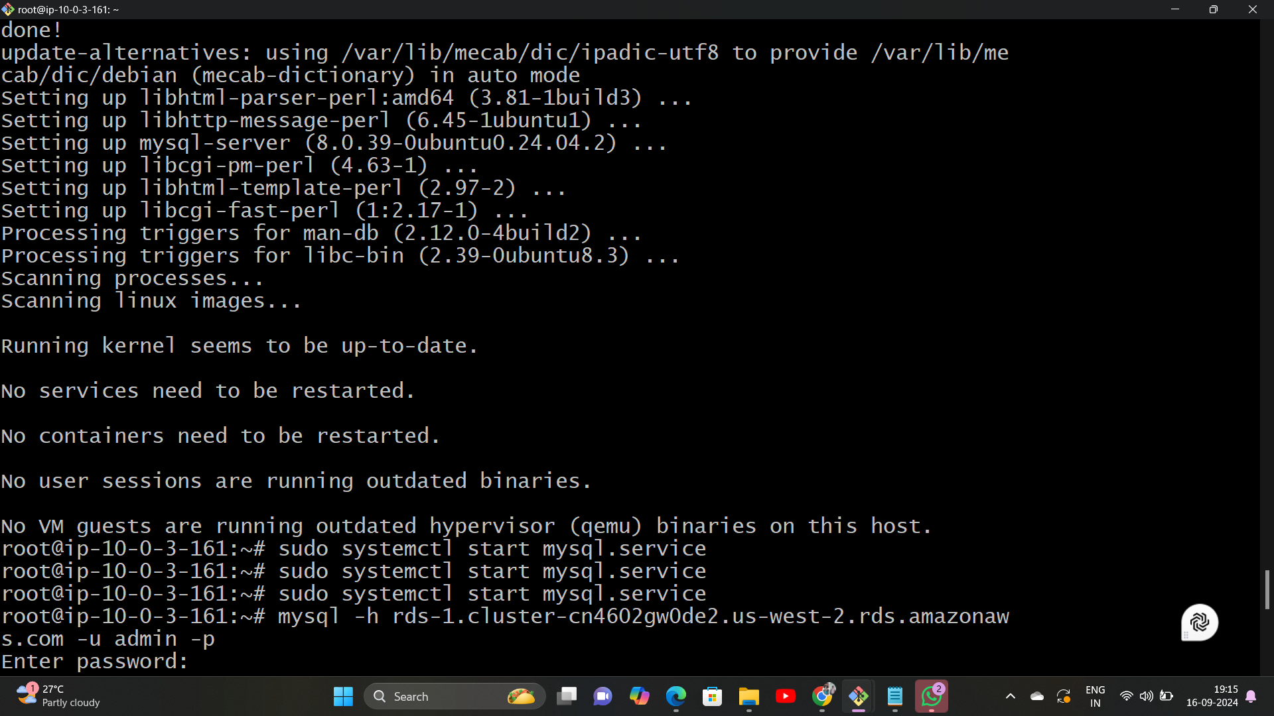

Slide 25
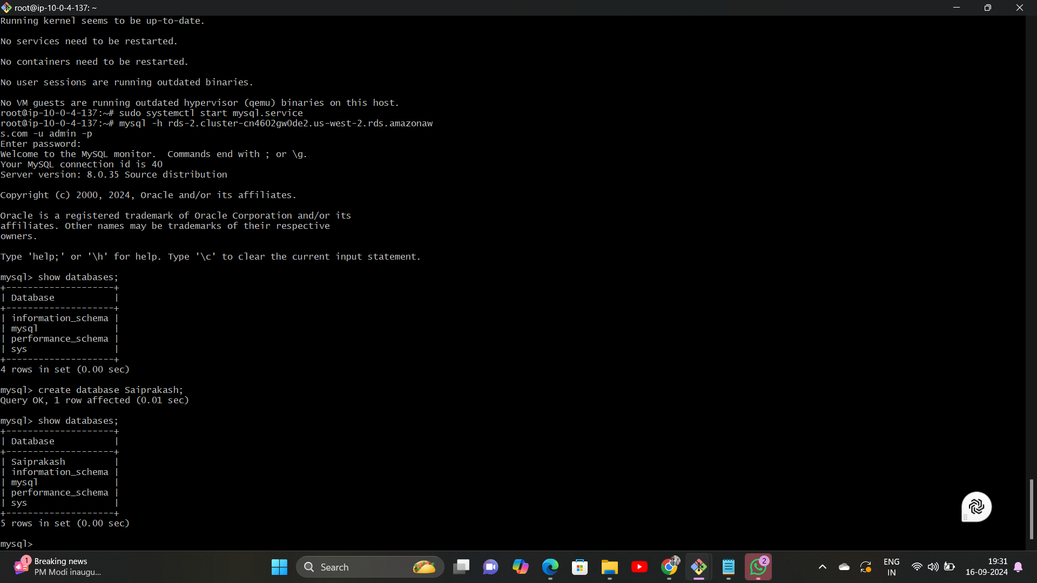

Slide 26
CONCLUSION
High Availability: Multi-AZ deployment for failover and redundancy.
Scalability: EC2 Auto Scaling, Load Balancer, and database scalability with Amazon RDS.
Security: Layered security with subnets and security groups ensuring controlled access.

Slide 27
THANK YOU

